Slide 1
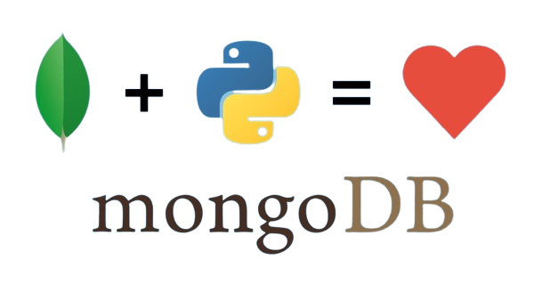

PYTHON WITH MONGO
Présenter par
Ayoub aarab
Mohamed ilyass el ghazi
Nourddine benyahya

Slide 2




Steps
Sommaire
Step 01
01
Installation
Use database / collection
Find()
Creation de database et collection
Step 01
Step 02
02
Step 02
Insert
aggregate
Step 03
03
Step 03
Delete
update

Slide 3
Steps
Sommaire
Step 01
01
Installation
Use database / collection
Find()
Creation de database et collection
Step 01
Step 02
02
Step 02
Insert
aggregate
Step 03
03
Step 03
Delete
update

Slide 4


DELETE

Slide 5
Steps
Sommaire
Step 01
01
Installation
Use database / collection
Find()
Creation de database et collection
Step 01
Step 02
02
Step 02
Insert
aggregate
Step 03
03
Step 03
Delete
update

Slide 6
DELETE

Slide 7
Steps
Sommaire
Step 01
01
Installation
Use database / collection
Find()
Creation de database et collection
Step 01
Step 02
02
Step 02
Insert
aggregate
Step 03
03
Step 03
Delete
update

Slide 8
DELETE

